Slide 1
The Most Important Data Structures in Python
By: Iman Khani Jazani
Senior Data Scientist, Community builder | Adin
AI and Data Specialist, Business Developer | AiHum
Adjunct Professor | Sharif University of Technology

Slide 2
Last lecture
Short Presentation
Review the Last Lecture
Different scops in Python
Programming with Python
Application of Programming in the Digital Age!

Slide 3
Today
Short Presentation
Review the Last Lecture
What is data structure?
For today: lists, nested lists (nested things), and tuples
Can we create a new data structure?
Programming with Python IDLE
Application of Programming in the Digital Age!

Slide 4
Together
Send your feedback about the class whenever you want!

Slide 5

Contact me
Gmail: ImanKhaniJazani@gmail.com
LinkedIn: https://www.linkedin.com/in/ImanKhaniJazani/
Telegram: @IKJ1992

Slide 6
Short Presentations

Slide 7
How to handle unbound local error in Python?

Slide 8
Review the Last Lecture

Slide 9

Functions
Function name (process)
$$y=F(x)$$
output
input

Slide 10
Modules

Slide 11
Packages

Slide 12
SuperPackages

Slide 13
What is Data Structure?

Slide 14
Definition
An organization of data for the purpose of making it easier to use.
Algorithm
Data Structure
Program

Slide 15
List

Slide 16
Nested list

Slide 17
Tuple

Slide 18
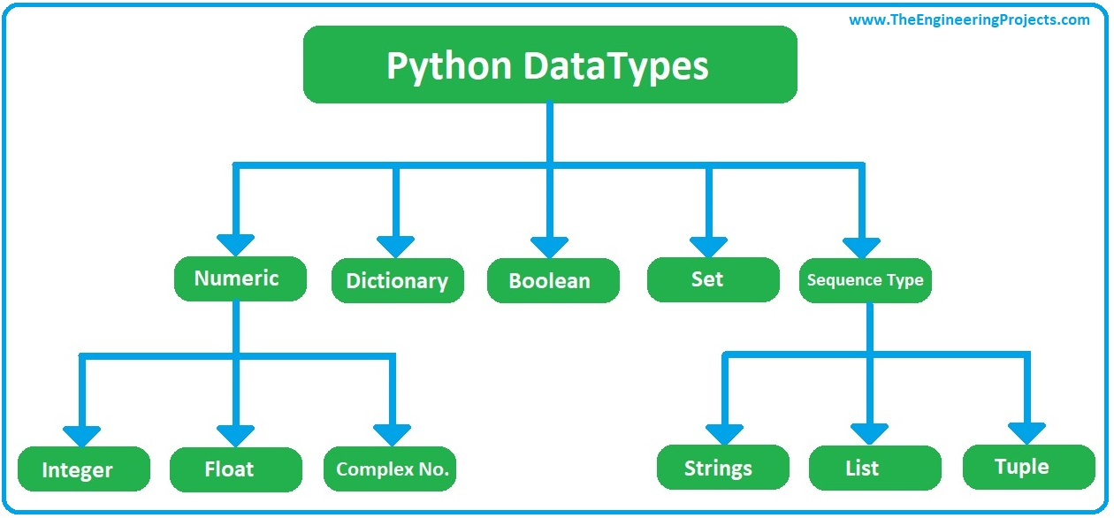
Python DataTypes

Slide 19
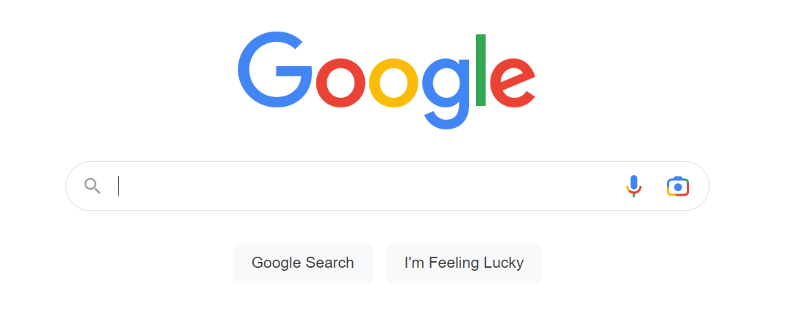
List vs. tuple

Slide 20
Can we create a new data structure?

Slide 21
List methods | what is methods?!?!

Slide 22
Why we want to create?
Useful structure
Useful methods

Slide 23
How we can create a new one? WHY we want to do?🤕

Slide 24
Programming with Python IDLE

Slide 25
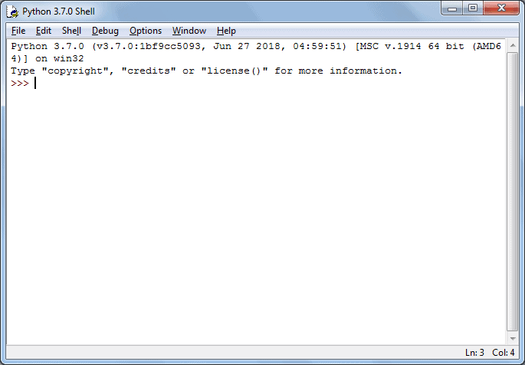
Let’s go for prompt-based coding…

Slide 26
Application of Programming in the Digital Age!

Slide 27

Drnext

Slide 28
Lecture Resources
P. Wentworth, J. Elkner, A. B. Downey, C. Meyers. How to Think Like a Computer Scientist: Learning with Python. 3rd Edition, Open Book Project, 2011.

